Slide 1
Prescribing Safety Assessment Training Workshop
Introduction to PSA Item authoring
Single Best Answer items
Dr Lynne Bollington

Slide 2
Agenda
SBA question development
PSA item styles
House style
Common pitfalls

Slide 3
SBAs have three parts:
A clinical scenario (the ‘stem’)
A question to be answered (the ‘lead-in’)
A list of possible answers (the ‘options’)

Slide 4
First decide on the testing point
Identify the topic (important, not trivial)
Draw material from your experience of candidates displaying:
unexpected ignorance
misconceptions
errors of judgement
Limit item to a single testing point
think about what precise knowledge is being tested
ensure that correct answer demonstrates knowledge being tested

Slide 5
Frame the item around the question
Build the stem as a fictional scenario with sufficient information to choose the correct answer (and no more)
Identify 4 plausible distractors that are:
incorrect/clearly less correct than the agreed answer
not widely divergent
not ‘all/none of the above’
All the options may be true, but one must clearly be the most important or most appropriate option

Slide 6
Agenda
SBA question development
PSA item styles
House style
Common pitfalls

Slide 7
Planning management items (MAN)
MAN items present:
a clinical scenario and a request to identify the most appropriate management option
The list of options should include:
medicines, IV fluids, investigations or other actions that would be of real benefit and others that would be less beneficial or harmful

Slide 8
Options can be prescriptions, investigations or referrals
Notes:
detailed enough to be plausible distractors

Slide 9
Providing information items (COM)
COM items present:
a clinical scenario where someone needs information about medicines
a request to identify the most important information that should be provided to the patient/carer/HCP
This will involve:
selecting the most important information and disregarding other potentially correct but less important information

Slide 10
Use language that is appropriate for the intended recipient
Notes:
More than one option can be correct, but only one is most important

Slide 11
Adverse drug reaction items
4 types of ADR item style:
A: identifying likely adverse reactions,
B: identifying drugs causing specific adverse drug reactions,
C: identifying drug interactions,
D: managing the adverse effects of a drug

Slide 12
Ensure answers don’t conflict with BNF (esp ADR frequencies)

Slide 13
Drug monitoring items (TDM)
TDM items present:
a scenario that involves making judgements about how best to assess the impact of planned or ongoing treatments
demonstrating an understanding of how to monitor the beneficial or harmful effects of medicines and when to do so
The correct course of action may involve:
deciding which tests or observations to perform
deciding which is the most appropriate indication of outcome
deciding on the timing of test measurements

Slide 14
What (and when) to monitor

Slide 15
Data interpretation items (DAT)
DAT items involve:
interpreting data in the light of a clinical scenario
deciding on the most appropriate course of action with regard to prescribing based on the data
The correct course of action may involve:
withdrawing a medicine
reducing its dose
no change
increasing its dose
prescribing a new medicine

Slide 16
DAT items MUST contain data that is required to answer the question

Slide 17
Agenda
SBA question development
PSA item styles
House style
Common pitfalls

Slide 18
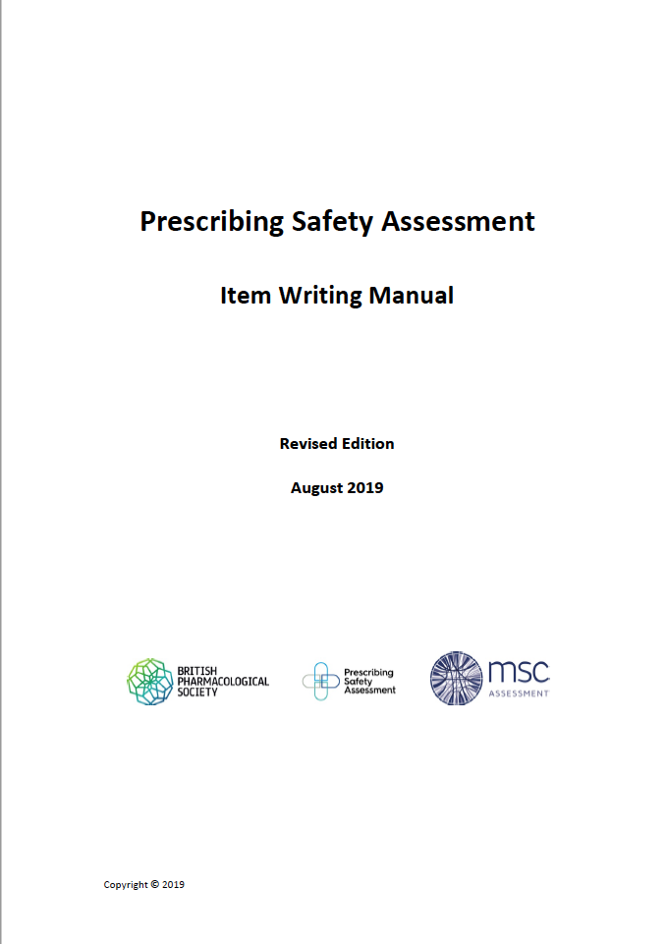
House style
PSA Item writing manual sets out preferred approach to drafting PSA items:
intended to ensure consistency of presentation to allow candidates to speed-read text and avoid wasting time
It includes:
detailed descriptions of each item style
guidance on good item writing
house style guide
accepted abbreviations
reference ranges

Slide 19
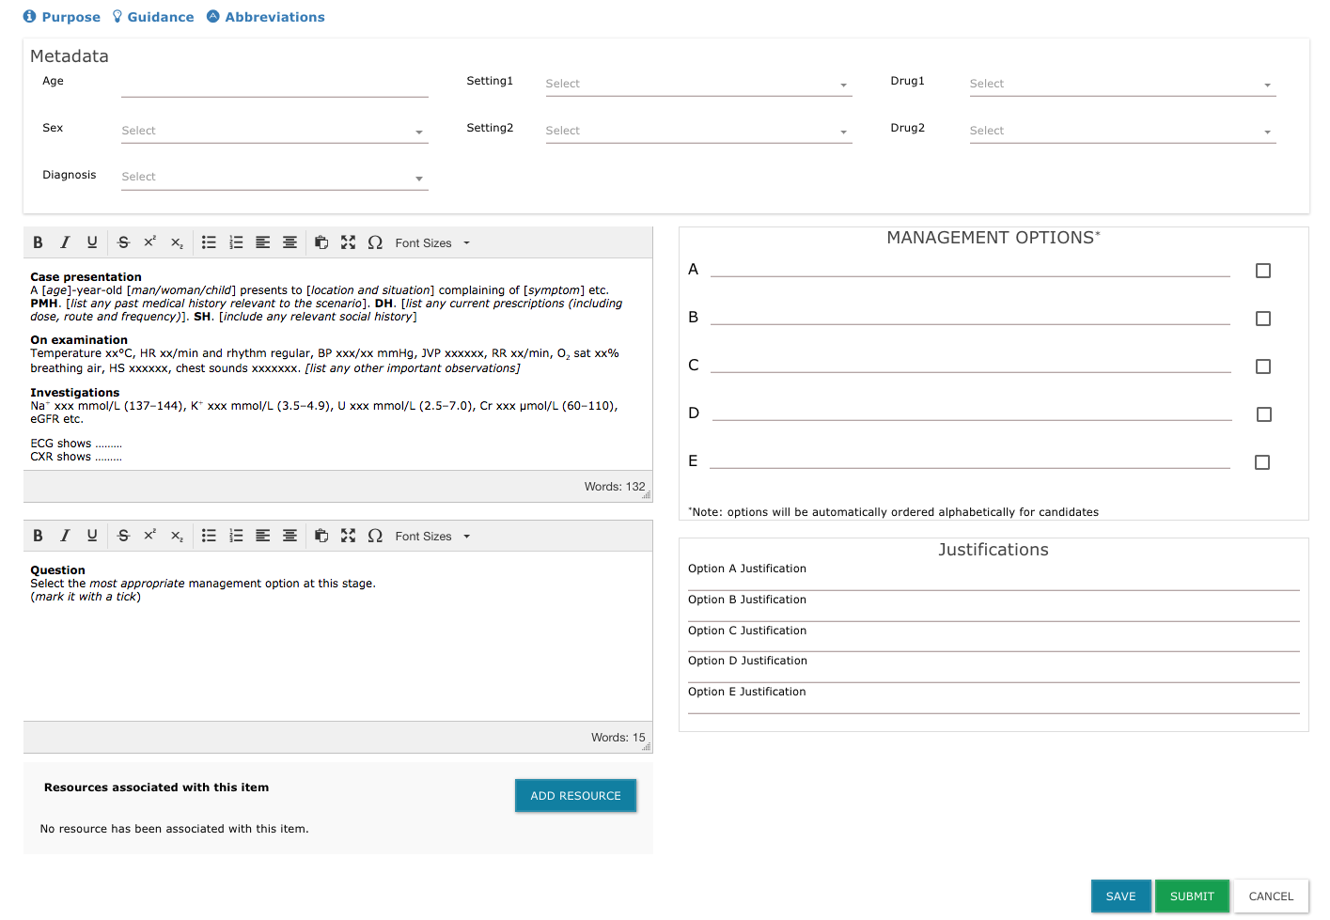
Templates provide typical length, structure and house style

Slide 20
Agenda
SBA question development
PSA item styles
House style
Common pitfalls

Slide 21
Common pitfalls
Item on the wrong template
Information presented out of order in case presentation, examination or investigations
Inclusion of superfluous detail in case presentation
Use of unlisted abbreviations
Options in Providing Information items using inappropriate language/terminology
Options listing drugs for which no indication is given in stem
Data Interpretation items containing no data, or data unlikely to affect decision re drug dosage
Incomplete Justifications for answers

Slide 22
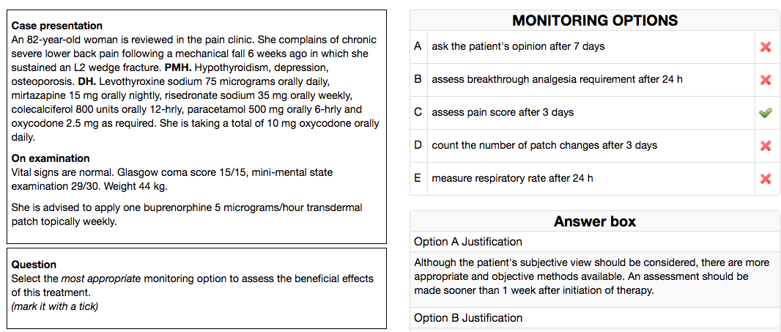
This item may have been ambiguous, or the optimum answer open to debate
Fac: 35.0%
Dis: 0.044

Slide 23
Items that require interpretation, and/or background knowledge, rather than ‘looking up’ skills perform best
Fac: 68.5%
Dis: 0.296

Slide 24
If you have questions, please contact me:
Lynne Bollington
Lead consultant to Prescribing Safety Assessment
lynne@bollington.net

